Slide 1

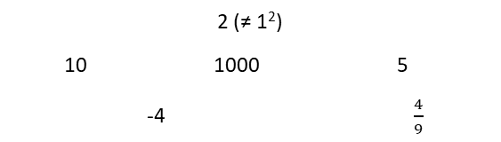
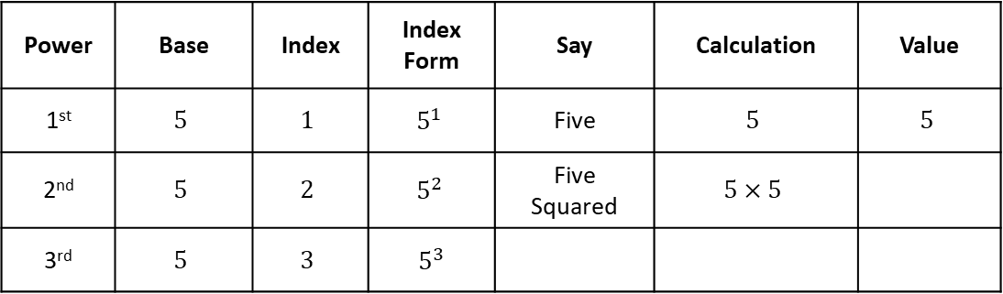
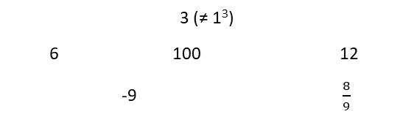
Subtopic 6 – Squares, Cubes and Roots
LEARNING OUTCOME: To understand square and cube numbers
Objectives:
To be able to recall the square numbers up to 15 squared
To be able to recall the cube numbers up to 10 cubed.
Keywords:
- Square
- Cube
Introduction:
Squares numbers and and cube numbers are ways of multiplying a number by itself a certain number of
times, creating what we call powers. When you square a number, you multiply it by itself. Cubing a
number means multiplying it by itself and then multiplying by itself again. Knowing how to work with
squares and cubes is an important skill, as it forms the foundation for understanding powers,
exponents and roots.
Definition
Characteristics
The process of creating a square number is called “squaring” and is shown using an index of 2
An integer multiplied by itself makes a square number
Examples
Square number
Non - Examples
2 (≠ 1²)
10 1000 5
-4 $\frac{4}{9}$
4 (= 2²) 9 (= 3²) 100 (= 10²)
484 (=22²) 1 (= 1²) 10 000 (= 100²)
Definition
Characteristics
The process of creating a cube number is called “cubing” and is shown using an index of 3
An integer multiplied by itself and then itself again makes a cube number
3
Examples
Cube number
Non - Examples
3 (≠ 1³)
6 100 12
-9 $\frac{8}{9}$
8 (= 2³) 27 (= 3³) 1000 (= 10³)
10 648 (=22³) 1 (= 1³) 1 000 000 (= 100³)
Index form and language
Example 1 - I do…
Power | Base | Index | Index Form | Say | Calculation | Value
1st | $$5$$ | $$1$$ | $$5^{1}$$ | Five | $$5$$ | $$5$$
2nd | $$5$$ | $$2$$ | $$5^{2}$$ | Five Squared | $$5×5$$
3rd | $$5$$ | $$3$$ | $5^{3}$

Slide 2
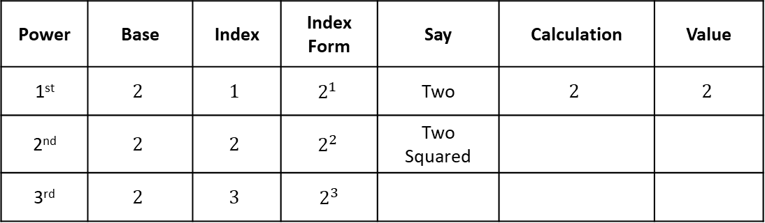
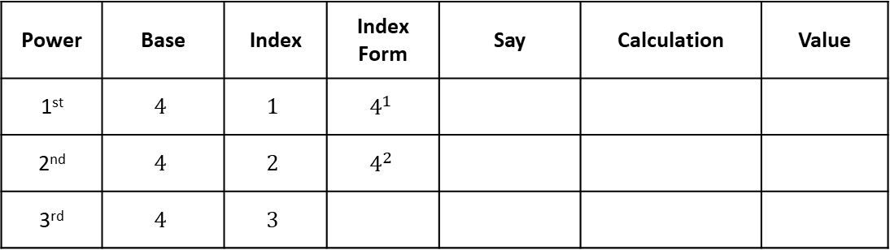
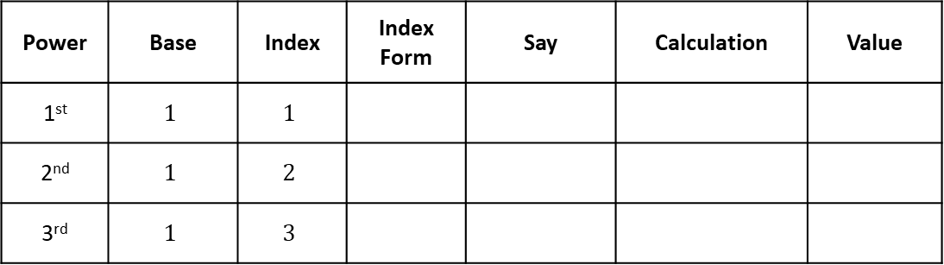
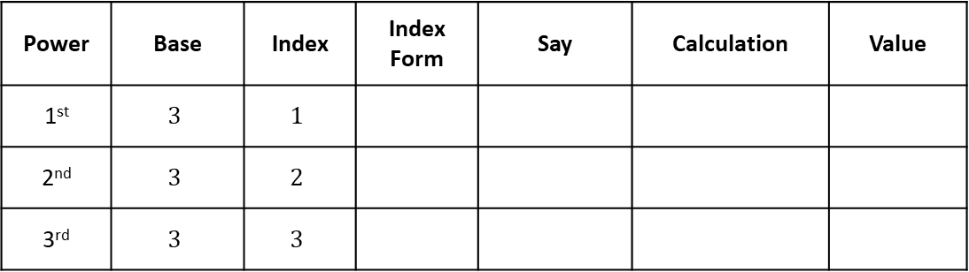
Example 2 – We do…
Power | Base | Index | Index Form | Say | Calculation | Value
1st | $$2$$ | $$1$$ | $$2^{1}$$ | Two | $$2$$ | $$2$$
2nd | $$2$$ | $$2$$ | $$2^{2}$$ | Two Squared
3rd | $$2$$ | $$3$$ | $2^{3}$
Example 3 – You do…
Power | Base | Index | Index Form | Say | Calculation | Value
1st | $$4$$ | $$1$$ | $$4^{1}$$
2nd | $$4$$ | $$2$$ | $$4^{2}$$
3rd | $$4$$ | $$3$$
Independent Practice
1. Fill in the blanks
a)
Power | Base | Index | Index Form | Say | Calculation | Value
1st | $$3$$ | $$1$$
2nd | $$3$$ | $$2$$
3rd | $$3$$ | $$3$$
b)
Power | Base | Index | Index Form | Say | Calculation | Value
1st | $$1$$ | $$1$$
2nd | $$1$$ | $$2$$
3rd | $$1$$ | $$3$$

Slide 3






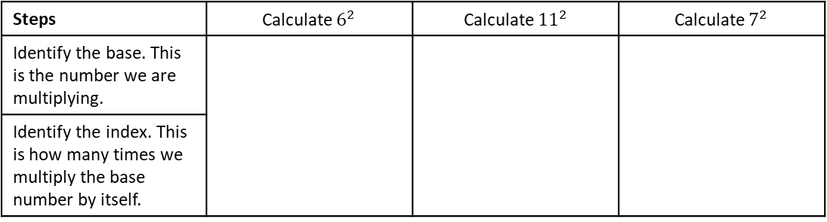










To be able to recall the square numbers up to 15 squared
Example 4 - I do…
Example 5 – We do…
Example 6 – You do…
Steps | Calculate $6^{2}$ | Calculate ${11}^{2}$ | Calculate $7^{2}$
Identify the base. This is the number we are multiplying.
Identify the index. This is how many times we multiply the base number by itself.
Independent Practice
2. Without using a calculator, calculate the value of:
a) $5^{2}$
b) $3^{2}$
c) $9^{2}$
d) $1^{2}$
e) $2^{2}$
f) $4^{2}$
g) $8^{2}$
h) ${10}^{2}$
i) The square of zero
j) Six squared
k)Twelve times twelve
l) ${13}^{2}$
m) ${14}^{2}$
n) ${15}^{2}$
o) 10 squared
y) ${10}^{2}+{13}^{2}$
z) ${11}^{2}+8^{2}$
aa) ${12}^{2} −7^{2}$
ab) ${13}^{2} −5^{2}$
p) ${20}^{2}$

Slide 4

















Example 7 - I do…
Example 8 – We do…
Example 9 – You do…
Steps | Calculate ${0.3}^{2}$ | Calculate ${1.2}^{2}$ | Calculate ${0.4}^{2}$
Identify the base. This is the number we are multiplying.
Identify the index. This is how many times we multiply the base number by itself.
Independent Practice
3. Calculate the following. You may use a calculator.
a) ${0.1}^{2}$
b) ${0.2}^{2}$
c) ${0.3}^{2}$
d) ${0.4}^{2}$
e) ${0.5}^{2}$
f) ${0.6}^{2}$
g) ${0.7}^{2}$
h) ${0.8}^{2}$
i) ${0.9}^{2}$
j) $1^{2}$
k)${1.1}^{2}$
l) ${1.2}^{2}$
m)${ 0.14}^{2}$
n) ${0.4}^{2}$ - ${0.3}^{2}$
o) ${1.1}^{2}+{0.2}^{2}$
p) ${1.2}^{2} −{0.5}^{2}$

Slide 5
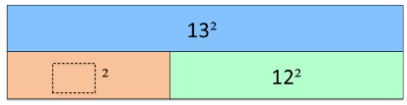
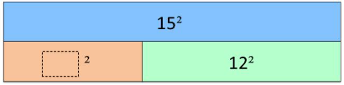

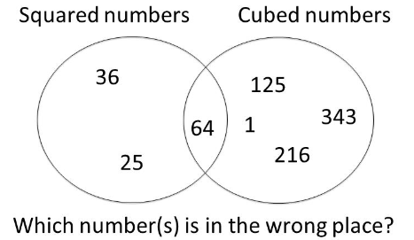





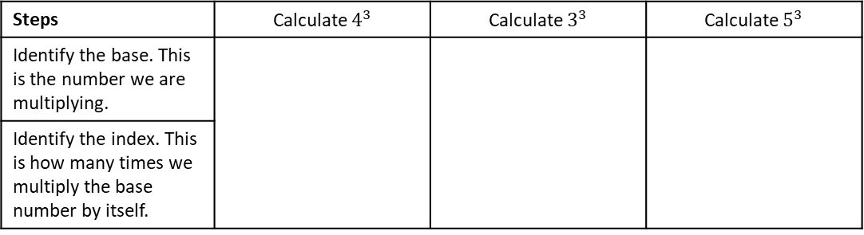







To be able to recall the cube numbers up to 10 cubed
Example 10 - I do…
Example 11 – We do…
Example 12 – You do…
Steps | Calculate $4^{3}$ | Calculate $3^{3}$ | Calculate $5^{3}$
Identify the base. This is the number we are multiplying.
Identify the index. This is how many times we multiply the base number by itself.
Independent Practice
4. Calculate the value of:
a)$1^{3}$
b)$2^{3}$
c)$3^{3}$
d)$4^{3}$
e)$5^{3}$
f)$6^{3}$
g)$7^{3}$
h)$8^{3}$
i)$9^{3}$
j) ${10}^{3}$
k)$2^{3}+1^{3}$
l)$2^{3}−1^{3}$
Mixed Practice
5. Fill in the blanks:
a)
6. Circle the number that is in the wrong
place in the Venn diagram:

Slide 6



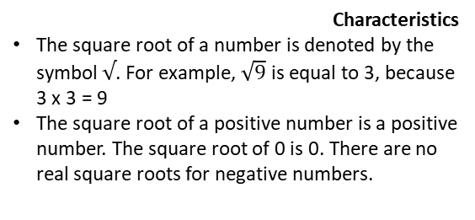











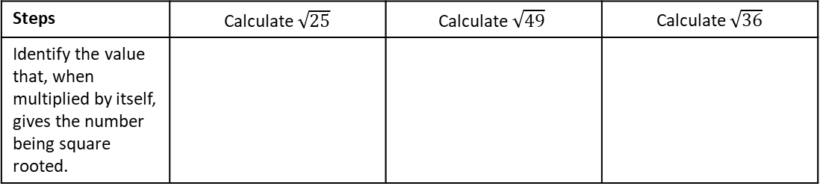

Square roots
Objectives:
To be able to recognise square roots as inverses of squares
To be able to recognise cube roots as inverses of cubes
Keywords:
- Square root
- Cube root
Introduction – Read and annotate:
Square roots and cube roots are the opposite, or inverse operations, of squaring and cubing. A square
root finds the original number that was squared, while a cube root finds the original number that was
cubed. Square and cube roots are especially important in algebra and geometry, where they help solve
equations involving areas, volumes and distances (Pythagoras’ Theorem).
The square root of a number is a value that, when multiplied by itself, gives the original number.
Definition
Characteristics
The square root of a number is denoted by the symbol $√$. For example, $\sqrt{9}$ is equal to 3, because 3 x 3 = 9
The square root of a positive number is a positive number. The square root of 0 is 0. There are no real square roots for negative numbers.
Examples
Square root
Non - Examples
$\sqrt{16}$ = 4, because 4 x 4 = 16
$$\sqrt[3]{}$$
$$\sqrt{\frac{25}{16}}$$
$\sqrt{1}$ = 1, because 1 x 1 = 1
$$\frac{\sqrt{25}}{\sqrt{16}}$$
$$\sqrt{4+5}$$
3
$\sqrt{0}$ = 0, because 0 x 0 = 0
$$\sqrt{5+12}$$
Calculating square roots up to $\sqrt{225}$
Example 1 - I do…
Example 2 – We do…
Example 3 – You do…
Steps | Calculate $\sqrt{25}$ | $$\text{Calculate} \sqrt{49}$$ | Calculate $\sqrt{36}$
Identify the value that, when multiplied by itself, gives the number being square rooted.
Independent Practice
1. Calculate the following:
a) $\sqrt{4}$
b) $\sqrt{9}$
c) $\sqrt{1}$
d) $\sqrt{64}$
f) $\sqrt{0}$
g) $\sqrt{121}$
h) $\sqrt{100}$
i) $\sqrt{81}$

Slide 7



















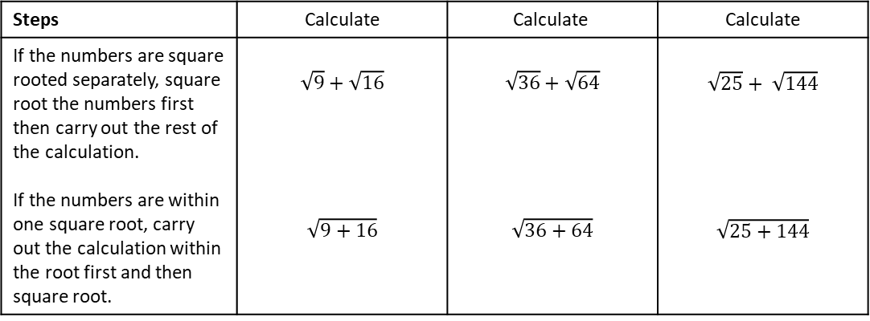





k) $\sqrt{144}$
l) $\sqrt{169}$
m) $\sqrt{196}$
n) $\sqrt{225}$
o) $\sqrt{400}$
p $\sqrt{900}$
q) $\sqrt{6400}$
r) $\sqrt{4900}$
Example 4 - I do…
Example 5 – We do…
Example 6 – You do…
Steps | Calculate | $$\text{Calculate}$$ | Calculate
If the numbers are square rooted separately, square root the numbers first then carry out the rest of the calculation. If the numbers are within one square root, carry out the calculation within the root first and then square root. | $$\sqrt{9}+\sqrt{16}$$ $$\sqrt{9+16}$$ | $$\sqrt{36}+\sqrt{64}$$ $$\sqrt{36+64}$$ | $$\sqrt{25}+ \sqrt{144}$$ $$\sqrt{25+144}$$
Independent Practice
2. Calculate the following:
a) $\sqrt{4}$
b) $\sqrt{3+1}$
c) $\sqrt{4}+\sqrt{1}$
d) $\sqrt{64}$
e) $\sqrt{32+32}$
f) $\sqrt{16}+\sqrt{25}$
g) $\sqrt{121−21}$
h) $\sqrt{64+36}$
i)$\sqrt{13+3}$
j) $\sqrt{5×5}$
k) $\sqrt{40−4}$
l) $\sqrt{225}$
m) $\sqrt{0}+\sqrt{1}$
n) $\sqrt{5+4}$
o) $\sqrt{10+1−2}$
p) $\sqrt{16}−\sqrt{9}+\sqrt{1}$

Slide 8
Subtopic 7a - Positive Indices and Laws of Indices
Objectives:
LEARNING OUTCOME: Understand the laws of indices
Keywords:
Equations
Indices
Exponents
Expressions
Variables
Write a number as a power of another number.
Understand what the different laws of Indices are.
How to multiply and divide indices
Look at problem solving questions.
Definition
Characteristics
Index laws are the rules that we must follow when simplifying algebraic or numerical terms involved indices
These can involve negatives addition and subtraction rules
Every different style of number, e.g. integer, fraction, negative, performs a different action
4⁶ = 4 × 4 × 4 × 4 × 4 × 4 | six lots of 4 multiplied together
6⁴ = 6 × 6 × 6 × 6 | four lots of 6 multiplied together
7³ = 7 × 7 × 7
Examples
Index Laws
Non - Examples
$a^{8}×a^{3}=a^{24},$ This is a non-example as the powers have been multiplied
$b^{10}÷b^{2}=b^{5},$ This is a non-example as the powers have been divided
$({c^{4})}^{2}=c^{16},$ This is a non-example as the powers have been powered
You can write a million as 1 000 000 = 10⁶.
A number multiplied by itself is the number ‘squared’. You need to know the square numbers (power 2) up to 15² = 225. How many of them can you write down from memory? You will also find it helpful to know the cubes numbers (power 3) up to 6³ = 216
$a^{2}×a^{4}=a^{6},$ The powers are added under multiplication
$b^{7}÷b^{2}=b^{5},$ The powers are subtracted under division
${{(c}^{3})}^{3}=c^{9},$ The powers are multiplied under power rules
Example 1 - I do…
Example 2 - We do…
Example 3 - You do…
Steps | Express in index notation | Express in index notation | Express in index notation
1) Count how many of the same base (number or letter) there are. | $2×2×2$ $$2×2×2×5×5$$ | $$3×3×3×3×3$$ $$3×3×3×4×4$$ | $$9×9×9×9$$ $$5×5×9×9$$
2) Write the total amounts of each number or letter as an index of each value.
INDEPENDENT PRACTICE
1. Write these expressions in index notation.
a) $2 × 2 × 2× 2$ | b) $3 × 3 × 3 × 3 × 3$
c) $7 × 7$ | d) $12× 12× 12$
e) $0.7× 0.7× 0.7× 0.7$ | f) $2×2×3×3$
g) $3 × 3 × 3×7 × 7$ | h) $7×7×7×7×12×12×12×15×15$
i) $12× 12× 12×0.7×0.7$ | j) $0.7× 0.7× 0.7× 0.7×0.3×0.3$

Slide 9
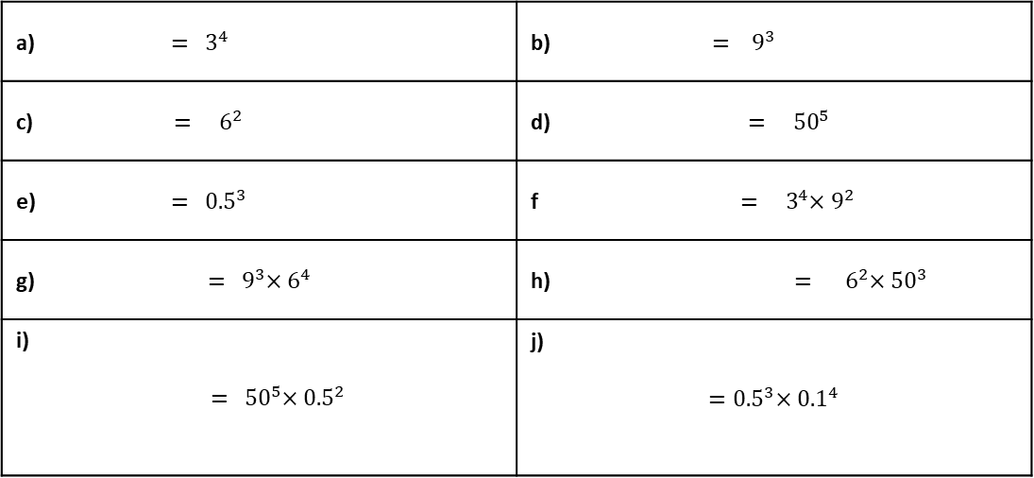
Example 4 - I do…
Example 5 - We do…
Example 6 - You do…
Steps | Express in expanded form
1) Look at the index of each base number or letter, write out that many of the value as a product | $$4^{5}$$ $$4^{5}×8^{2}$$ | $$6^{2}$$ $$6^{2}×7^{3}$$ | $$9^{3}$$ $$9^{4}×11^{3}$$
INDEPENDENT PRACTICE
2. Write these expressions in expanded form.
a) ${ = 3}^{4}$ | b) ${ = 9}^{3}$
c) ${ = 6}^{2}$ | d)${= 50}^{5}$
e) ${ = 0.5}^{3}$ | f${ = 3}^{4}×9^{2}$
g) ${ = 9}^{3}×6^{4}$ | h) ${ = 6}^{2}×{50}^{3}$
i) $${ = 50}^{5}×{0.5}^{2}$$ | j) $${=0.5}^{3}×{0.1}^{4}$$
Example 7 - I do…
Example 8 - We do…
Example 9 - You do…
Steps | Express in index notation
1) Count how many of the same base (number or letter) there are. | $$x×x×x$$ $$c×c×d×d×d×d$$ | $$y×y×y×y×y$$ $$y×y×y×y×z×z$$ | $$a×a$$ $$a×a×b×b×b$$
2) Write the total amounts of each number or letter as an index of each value. | $$c×c×d×d×d×d$$ | $$y×y×y×y×z×z$$ | $$a×a×b×b×b$$

Slide 10
INDEPENDENT PRACTICE
3. Write these in index notation
a) $x×x×x×x$ | b) $y×y×y$
c) $m×m×m×m×m$ | d) $t×t×t×t$
e) $m×m×m×m×m×m$ | f) $t×t×t×t$
g) $w×w×w×w×w$ | h) $x×x×y×y$
i) $t×t×x×x×m×m$ | j) $w×w×w×t×t×y×y×y×y$
Example 10 - I do…
Example 11 - We do…
Example 12 - You do…
Steps | Express in expanded form
1) Look at the index of each base (number or letter), write out that many of the value as a product | $$x^{5}$$ $$x^{5}×y^{2}$$ | $$y^{3}$$ $$y^{2}×z^{2}$$ | $$a^{2}$$ $$a^{3}×b^{4}$$
INDEPENDENT PRACTICE
4. Write these out in expanded form.
a) $x^{3}$ | b) $y^{4}$
c) $m^{4}$ | d) $z^{3}×w^{4}$
e) $a^{5}×b$ | f) $c^{3}×d^{2}$
g) $a×b^{2}×c^{3}$ | h) $d^{4}×e^{3}×f^{3}$
i) $z^{3}×w^{4}×m^{5}$ | j) $h^{3}×m^{2}×n^{4}$

Slide 11
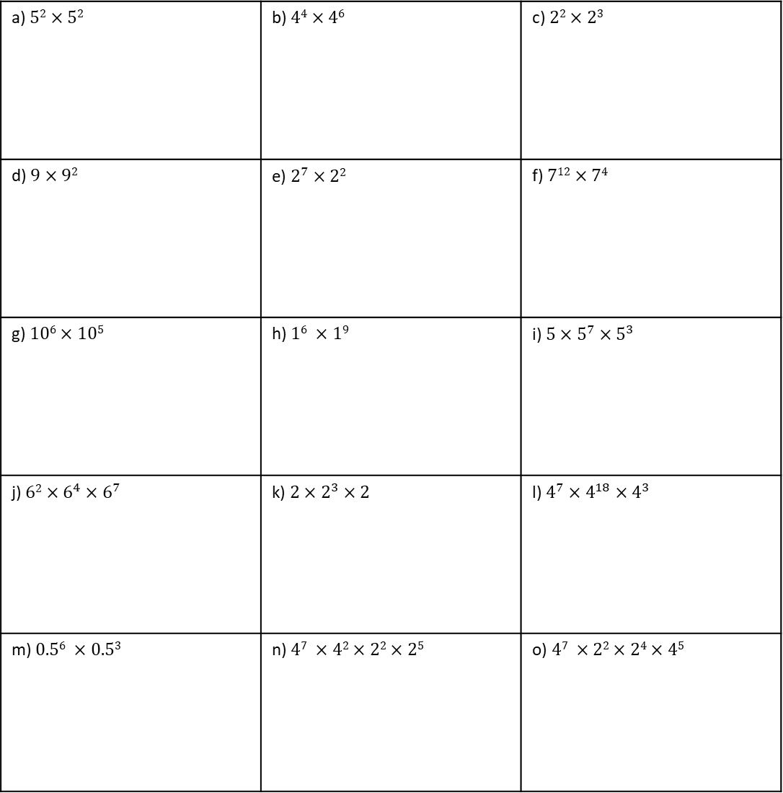
Example 13 - I do…
Example 14 – We do…
Example 15 – You do…
Steps | Simplify
 | $$5^{2}×5^{4}$$ | $$4^{2}×4×4^{3}$$ | $$7^{3}×7^{2}$$
INDEPENDENT PRACTICE
5. Simplify.
a) $52×52$ | b) $44×46$ | c) $22×23$
d) $9×92$ | e) $2^{7}×22$ | f) $712×74$
g) $106×105$ | h) $16 ×19$ | i) $5×5^{7}×5^{3}$
j) $62×6^{4}×6^{7}$ | k) $2×2^{3}×2$ | l) $4^{7}×4^{18}×4^{3}$
m) $0.56 ×0.53$ | n) $47 ×42×22×25$ | o) $47 ×22×24×45$

Slide 12
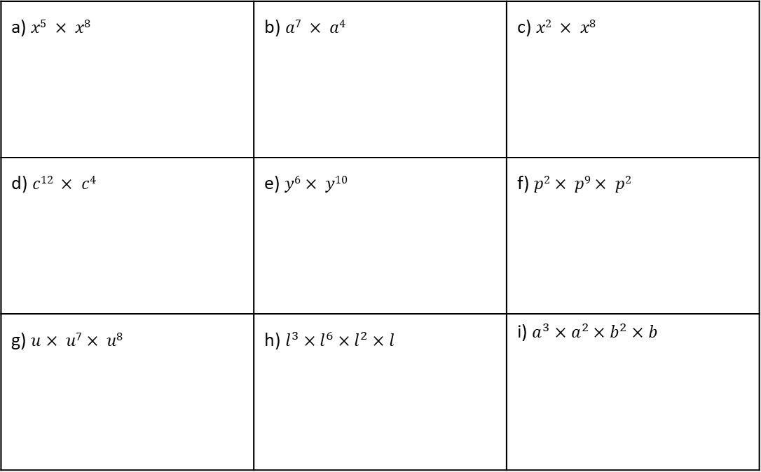
Example 16 - I do…
Example 17 – We do…
Example 18 – You do…
Steps | Simplify
 | $$a^{4}×a^{3}$$ | $$b^{2}×b^{2}×b^{3}$$ | $$c^{3}×c×c^{2}$$
INDEPENDENT PRACTICE
6. Simplify.
a) $x5 × x8$ | b) $a7 × a4$ | c) $x2 × x8$
d) $c12 × c4$ | e) $y6× y10$ | f) $p2× p9× p2$
g) $u× u7× u8$ | h) $l^{3}×l^{6}×l^{2}×l$ | i) $a^{3}×a^{2}×b^{2}×b$
KNOWLEDGE CHECK
7. Work out.
9 + -3 = | b) 10 + -4 = | c) 15 + -10 = | d) 23 + -17 =
e) 4 + -5 = | f) -6 + 7 = | g) -8 + 12 = | h) -12 + 8 =
i) -9 + -3 = | j) -10 + -4 = | k) -5 + -10 = | l) -23 + -17 =

Slide 13
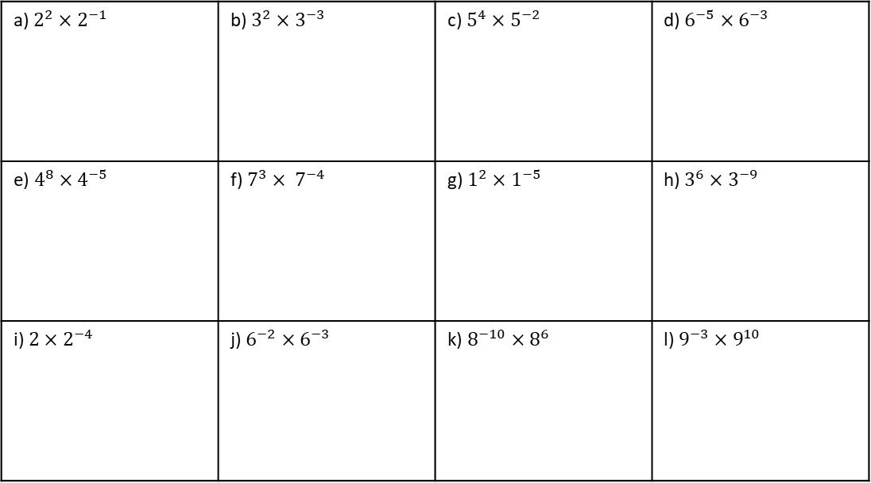
Example 19 - I do…
Example 20 – We do…
Example 21 – You do…
Steps | Simplify
When multiplying powers with the same base, we ADD the indices. | $$5^{2}×5^{−4}$$ $$5^{−2}×5^{−4}$$ | $$4^{−2}×4^{9}$$ $$4^{−2}×4^{−9}$$ | $$2^{4}×2^{−3}$$ $$2^{−4}×2^{−3}$$
INDEPENDENT PRACTICE
8. Simplify
a) $2^{2}×2^{−1}$ | b) $3^{2}×3^{−3}$ | c) $5^{4}×5^{−2}$ | d) $6^{−5}×6^{−3}$
e) $4^{8}×4^{−5}$ | f) $7^{3}× 7^{−4}$ | g) $1^{2}×1^{−5}$ | h) $3^{6}×3^{−9}$
i) $2×2^{−4}$ | j) $6^{−2}×6^{−3}$ | k) $8^{−10}×8^{6}$ | l) $9^{−3}×9^{10}$
Example 22 - I do…
Example 23 – We do…
Example 24 – You do…
Steps | Simplify
When multiplying powers with the same base, we ADD the indices. | $$b^{−7}×b^{9}$$ | $$m^{−3}×m^{−5}$$ | $$t^{5}×t^{−3}$$

Slide 14
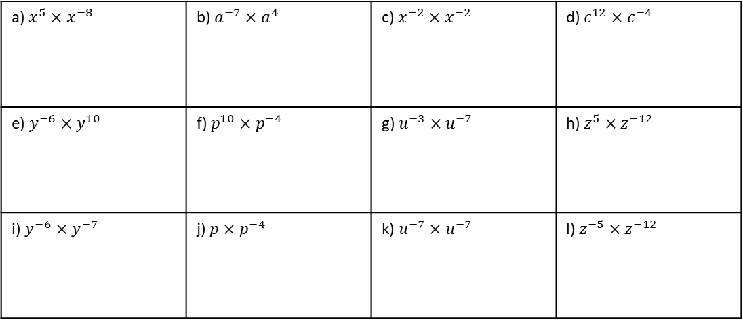
INDEPENDENT PRACTICE
9. Simplify
a) $x^{5}×x^{−8}$ | b) $a^{−7}×a^{4}$ | c) $x^{−2}×x^{−2}$ | d) $c^{12}×c^{−4}$
e) $y^{−6}×y^{10}$ | f) $p^{10}×p^{−4}$ | g) $u^{−3}×u^{−7}$ | h) $z^{5}×z^{−12}$
i) $y^{−6}×y^{−7}$ | j) $p×p^{−4}$ | k) $u^{−7}×u^{−7}$ | l) $z^{−5}×z^{−12}$
Example 25 - I do…
Example 26 – We do…
Example 27 – You do…
Steps | Simplify | Simplify | Simplify
Multiply the coefficients. | $$4x^{2}×{5x}^{3}$$ | $$2x^{5}×x^{4}$$ | 5$x^{2}×{3x}^{7}$
Multiply the variables (add the indices)
Simplify (put together)
INDEPENDENT PRACTICE
9. Simplify
$$a) 2x^{2}×x^{3}$$
$$b) 4x^{7}×x^{10}$$
$$c) x^{5}×{8x}^{5}$$
$$d) 2x^{3}×{3x}^{5}$$
$$e) 4x^{8}×{4x}^{2}$$
$$f) {5x}^{2}×3x$$
$$g) 7x^{2}×{4x}^{8}$$
$$h) 4x^{10}×{10x}^{2}$$
$$i) {3x}^{5}×8x^{5}$$

Slide 15
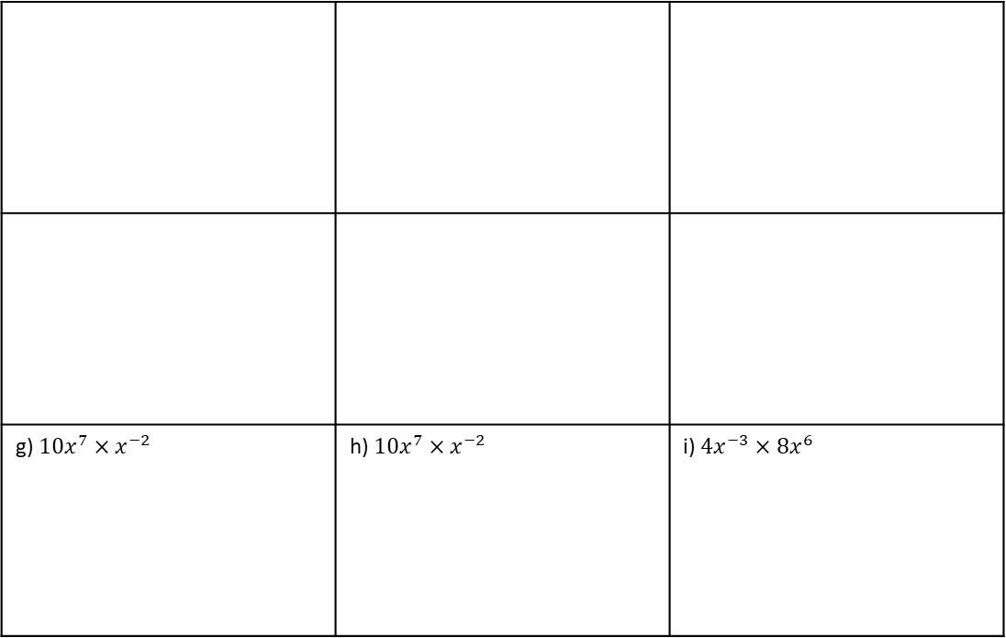
$$j) 11x^{22}×{4x}^{8}$$
$$k) 3x^{8}×{2x}^{2}$$
$$l) 3x^{5}×{7x}^{3}$$
$$m) 8x^{2}×{2x}^{3}$$
$$n) 15x^{6}×3x$$
$$o) x^{5}×9x^{10}$$
Example 28 - I do…
Example 29 – We do…
Example 30 – You do…
Steps | Simplify
Multiply the coefficients. | $$5x^{−2}×x^{−3}$$ | $$2x^{5}×{3x}^{−3}$$ | $$2x^{−2}×{4x}^{5}$$
Multiply the variables (add the indices)
Simplify (put together)
INDEPENDENT PRACTICE
11. Simplify
g) $10x^{7}×x^{−2}$ | h) $10x^{7}×x^{−2}$ | i) $4x^{−3}×8x^{6}$
a) $7x^{−2}×4x4$
b) $2x^{−4}×11x^{−7}$
c) $6x^{−7}×6x^{−11}$
d) $3x^{−2}×8x^{−6}$
e) $5x^{−4}×5x^{2}$
f) $12x^{−8}×3x^{−4}$

Slide 16
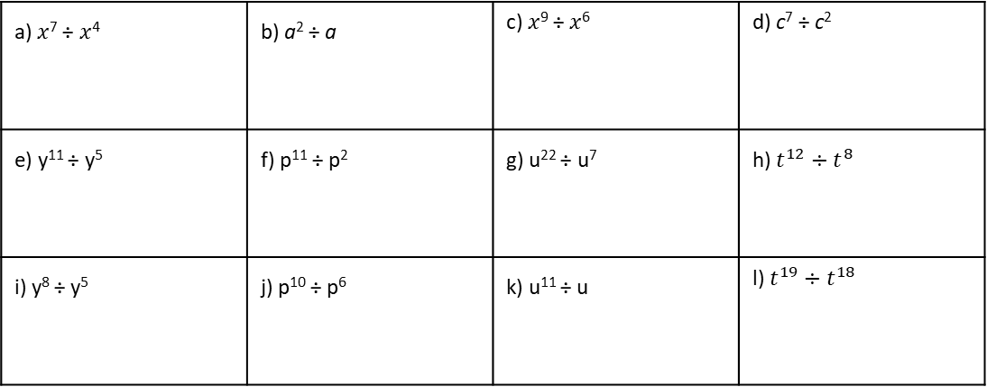
Example 31 - I do…
Example 32 – We do…
Example 33 – You do…
Steps | Simplify
 | $5^{7}÷5^{4}$ $$x^{6}÷x^{4}$$ | $$4^{5}÷4^{3}$$ $$y^{4}÷y^{3}$$ | $$8^{7}÷8^{3}$$ $$z^{5}÷z^{2}$$
INDEPENDENT PRACTICE
12. Simplify
a) 3² ÷ 3² | b) 4⁴ ÷ 4³ | c) 2⁷ ÷ 2⁵ | d) 9⁵ ÷ 9²
e) 2¹⁰ ÷ 2² | f) 7¹² ÷ 7⁴ | g) 10¹⁰ ÷ 10⁵ | h) 1⁶ ÷ 1
i) 5⁹ ÷ 5⁸ | j) 6¹⁴ ÷ 6¹⁰ | k) 2¹¹ ÷ 2 | l) 4²⁰ ÷ 4¹⁸
13. Simplify
a) $x$⁷ ÷ $x$⁴ | b) a² ÷ a | c) $x$⁹ ÷ $x$⁶ | d) c⁷ ÷ c²
e) y¹¹ ÷ y⁵ | f) p¹¹ ÷ p² | g) u²² ÷ u⁷ | h) $t^{12}÷t^{8}$
i) y⁸ ÷ y⁵ | j) p¹⁰ ÷ p⁶ | k) u¹¹ ÷ u | l) $t^{19}÷t^{18}$

Slide 17
KNOWLEDGE CHECK
14. Work out.
a) 3 - 5 = | b) 1 – 5 = | c) 2 – 7 = | d) 6 – 10 =
e) 13 – 28 = | f) -3 – 5 = ` | g) -1 – 5 = | h) -1 – -5 =
i) -2 – -7 = | j) -3 – -1 = | k) 12.3 – 14 = | l) -12.3 – 14 =
Example 34 - I do…
Example 35 – We do…
Example 36 – You do…
Steps | Simplify
When dividing powers with the same base, we SUBTRACT the indices. | $$5^{7}÷5^{−4}$$ $$x^{9}÷x^{−4}$$ | $$4^{−12}÷4^{9}$$ $$x^{−2}÷x^{5}$$ | $$8^{−4}÷8^{−9}$$ $$x^{−6}÷x^{−2}$$
INDEPENDENT PRACTICE
14. Simplify
a) 4² ÷ 4⁻¹ | b) 5² ÷ 5⁻³ | c) 7⁴ ÷ 7⁻² | d) 2⁵ ÷ 2⁻³
e) 9⁸ ÷ 9⁻⁵ | f) 5³ ÷ 5⁻⁴ | g) 1² ÷ 1⁻⁵ | h) 6⁶ ÷ 6⁻⁹
i) 6 ÷ 6⁻⁴ | j) 8⁻² ÷ 8³ | k) 8⁻⁴ ÷ 8⁶ | l) 2⁻³ ÷ 2¹⁰

Slide 18
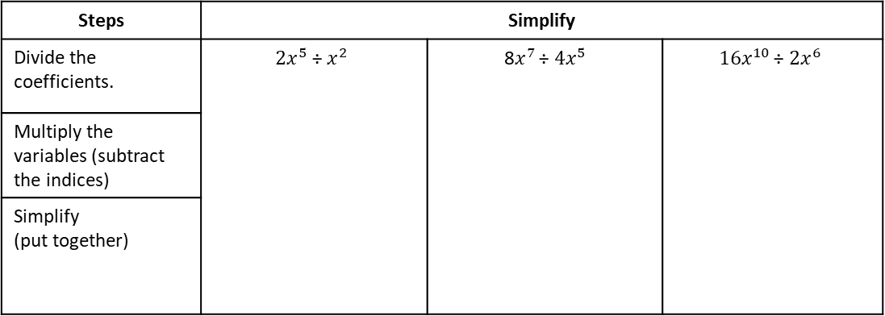
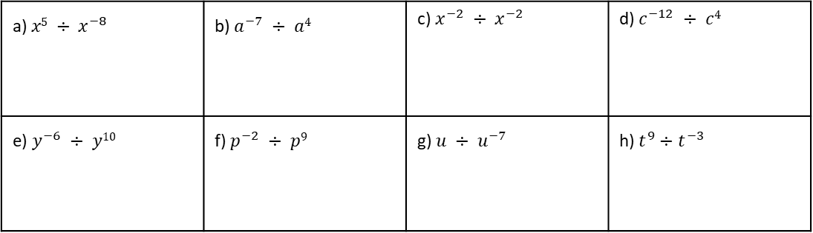
15. Simplify
a) $x5 ÷ x^{−8}$ | b) $a^{−7} ÷ a4$ | c) $x^{−2} ÷ x^{−2}$ | d) $c^{−12} ÷ c4$
e) $y^{−6} ÷ y10$ | f) $p^{−2} ÷ p9$ | g) $u ÷ u^{−7}$ | h) $t^{9}÷t^{−3}$
Example 37 - I do…
Example 38 – We do…
Example 39 – You do…
Steps | Simplify
Divide the coefficients. | $$2x^{5} \text{÷} x^{2}$$ | 8$x^{7 }\text{÷} {4x}^{5}$ | $$16x^{10 }\text{÷} {2x}^{6}$$
Multiply the variables (subtract the indices)
Simplify (put together)
INDEPENDENT PRACTICE
16. Simplify
a) $6x7 ÷ 3x4$
b) $6x8 ÷ 2x3$
c) $6x11 ÷ 6x7$
d) $24b12 ÷ 8b9$
e) $18b14 ÷ 2b2$
f) $9b7 ÷ 3b2$
g) $7c9 ÷ c4$
h) $20c7 ÷ 5c4$
i) $45c7 ÷ 9c7$

Slide 19
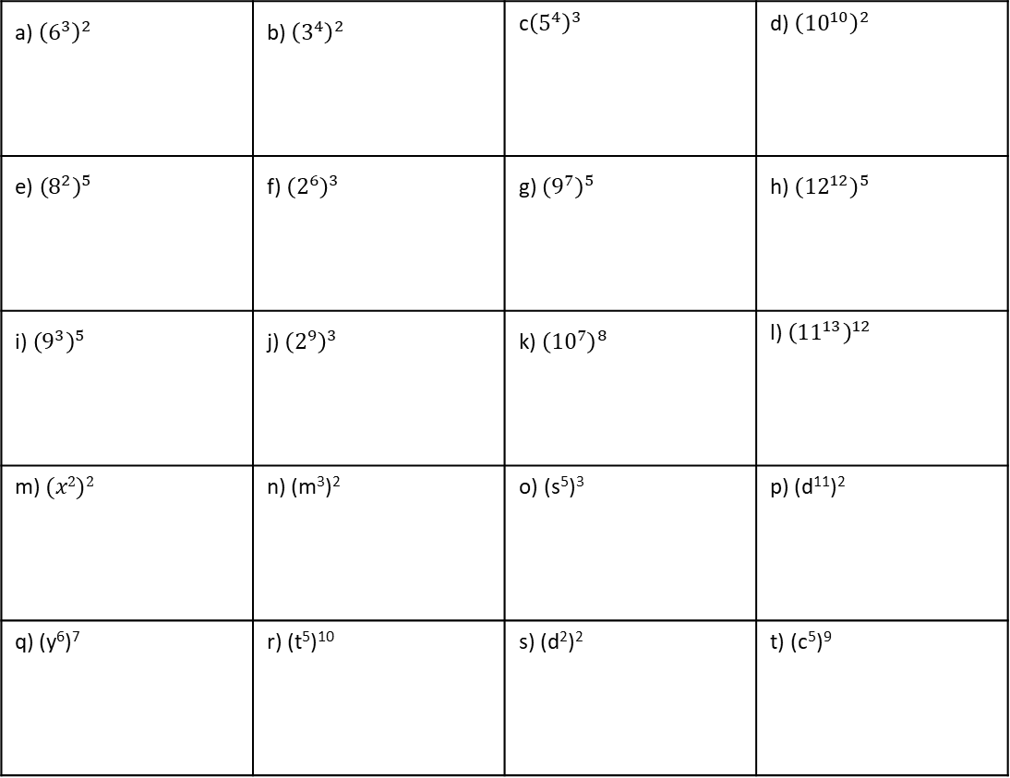
Example 43 - I do…
Example 44 – We do…
Example 45 – You do…
Steps | Simplify
 | $${\left(5^{2}\right)}^{3}$$ $${\left(x^{2}\right)}^{3}$$ | $${\left(3^{4}\right)}^{2}$$ $${\left(y^{6}\right)}^{2}$$ | $${\left(7^{5}\right)}^{3}$$ $${\left(z^{3}\right)}^{4}$$
INDEPENDENT PRACTICE
18. Simplify
a) ${\left(6^{3}\right)}^{2}$ | b) ${\left(3^{4}\right)}^{2}$ | c${\left(5^{4}\right)}^{3}$ | d) ${\left({10}^{10}\right)}^{2}$
e) ${\left(8^{2}\right)}^{5}$ | f) ${\left(2^{6}\right)}^{3}$ | g) ${\left(9^{7}\right)}^{5}$ | h) ${\left({12}^{12}\right)}^{5}$
i) ${\left(9^{3}\right)}^{5}$ | j) ${\left(2^{9}\right)}^{3}$ | k) ${\left({10}^{7}\right)}^{8}$ | l) ${\left({11}^{13}\right)}^{12}$
m) $(x2)2$ | n) (m³)² | o) (s⁵)³ | p) (d¹¹)²
q) (y⁶)⁷ | r) (t⁵)¹⁰ | s) (d²)² | t) (c⁵)⁹

Slide 20
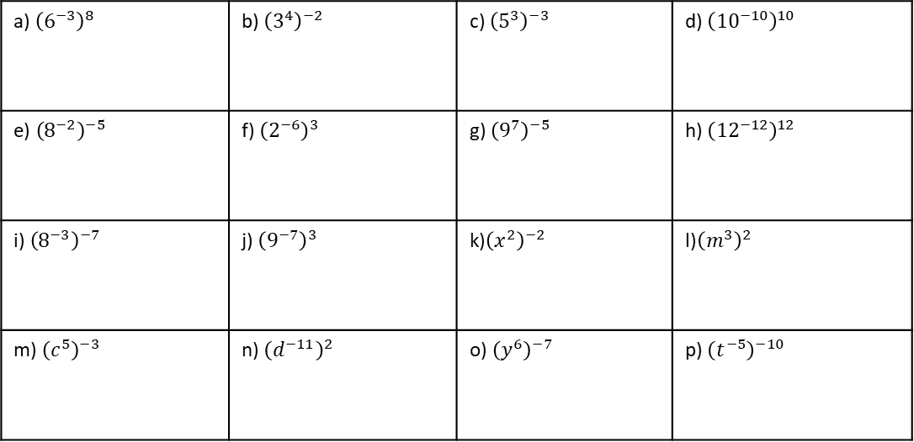
KNOWLEDGE CHECK
19. Work out.
a) 9 × -3 = | b) 10 × -4 = | c) 15 × -10 = | d) -2 × -7 =
e) 4 × -5 = | f) -6 × 7 = | g) -8 × 12 = | h) -12 × 8 =
i) -9 × -3 = | j) -10 × -4 = | k) -0.5 × -10 = | l) -23 × -17 =
Example 46 - I do…
Example 47 – We do…
Example 48 – You do…
Steps | Simplify
We MULTIPLY the indices. | $${\left(5^{2}\right)}^{−3}$$ $${\left(x^{−2}\right)}^{−3}$$ | $${\left(6^{−4}\right)}^{2}$$ $${\left(y^{−10}\right)}^{−2}$$ | $${\left(8^{−3}\right)}^{−4}$$ $${\left(z^{−5}\right)}^{4}$$
INDEPENDENT PRACTICE
20. Simplify
a) ${\left(6^{−3}\right)}^{8}$ | b) ${\left(3^{4}\right)}^{−2}$ | c) ${\left(5^{3}\right)}^{−3}$ | d) ${\left({10}^{−10}\right)}^{10}$
e) ${\left(8^{−2}\right)}^{−5}$ | f) ${\left(2^{−6}\right)}^{3}$ | g) ${\left(9^{7}\right)}^{−5}$ | h) ${\left({12}^{−12}\right)}^{12}$
i) ${\left(8^{−3}\right)}^{−7}$ | j) ${\left(9^{−7}\right)}^{3}$ | k)${\left(x^{2}\right)}^{−2}$ | l)${\left(m^{3}\right)}^{2}$
m) ${\left(c^{5}\right)}^{−3}$ | n) ${\left(d^{−11}\right)}^{2}$ | o) ${\left(y^{6}\right)}^{−7}$ | p) ${\left(t^{−5}\right)}^{−10}$

Slide 21
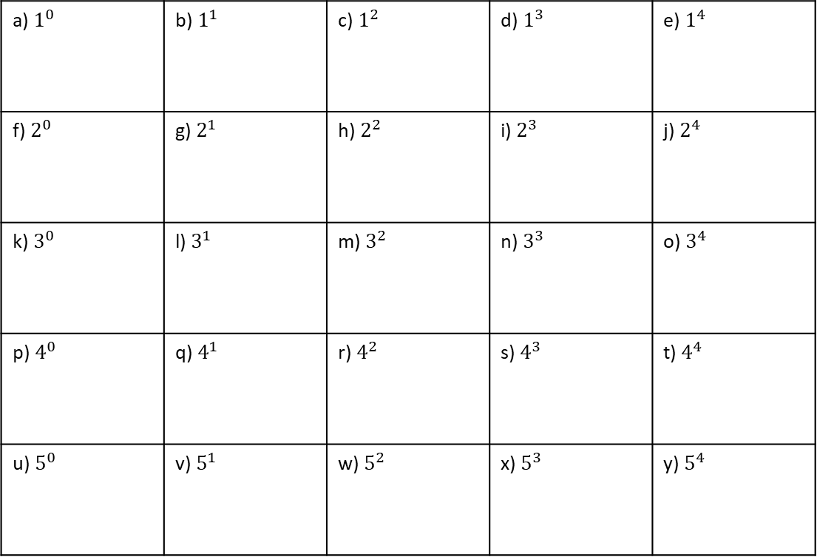
Subtopic 7b – Zero and Negative Indices
LEARNING OUTCOME: State and apply the definition of zero, negative indices
Objectives:
Keywords:
Negative Indices
Zero Indices
Positive Integers
Expressions
Index Notation
How to calculate zero indices.
Understand and calculate negative indices.
Apply understanding of the above to problem solving questions.
Definition
Characteristics
When the index of a value is negative we must make the value the reciprocal of it, to then resolve the index.
If an index is 0, the answer is always 1
Negative powers will result in fractions, often have a large square number as its denominator
0 powers make the answer always 1
4⁶ = 4 × 4 × 4 × 4 × 4 × 4 | six lots of 4 multiplied together
6⁴ = 6 × 6 × 6 × 6 | four lots of 6 multiplied together
7³ = 7 × 7 × 7
Examples
Negative Indices
Non - Examples
$a^{0}=1$, anything to the power 0 is 1
$b^{−7}={\left(\frac{1}{b}\right)}^{7}=\frac{1}{b^{7}}$, the reciprocal is taken then the powered
${\left(\frac{3}{4}\right)}^{−2}={\left(\frac{4}{3}\right)}^{2}=\left(\frac{4^{2}}{3^{2}}\right)=\frac{16}{9}$, if a fraction is raised to the negative power, then the reciprocal of the fraction is taken
$8^{0}=0$, this is a non-example as the value has been multiplied by 0
$b^{−10}=−b^{10},$ This is a non-example as the base has become negative, rather than the reciprocal
${\left(\frac{2}{5}\right)}^{2}=\frac{4}{10}$This is a non-example as the values have been multiplied rather than squared
You can write a million as 1 000 000 = 10⁶.
A number multiplied by itself is the number ‘squared’. You need to know the square numbers (power 2) up to 15² = 225. How many of them can you write down from memory? You will also find it helpful to know the cubes numbers (power 3) up to 6³ = 216
Knowledge check
1. Evaluate
a) $1^{0}$ | b) $1^{1}$ | c) $1^{2}$ | d) $1^{3}$ | e) $1^{4}$
f) $2^{0}$ | g) $2^{1}$ | h) $2^{2}$ | i) $2^{3}$ | j) $2^{4}$
k) $3^{0}$ | l) $3^{1}$ | m) $3^{2}$ | n) $3^{3}$ | o) $3^{4}$
p) $4^{0}$ | q) $4^{1}$ | r) $4^{2}$ | s) $4^{3}$ | t) $4^{4}$
u) $5^{0}$ | v) $5^{1}$ | w) $5^{2}$ | x) $5^{3}$ | y) $5^{4}$

Slide 22
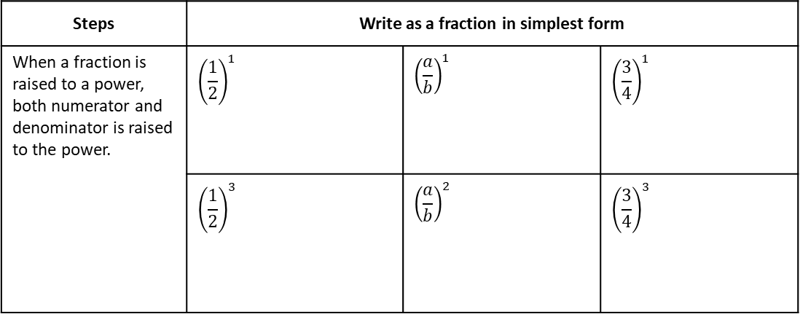
Example 1 - I do…
Example 2– We do…
Example 3 – You do…
Steps | Evaluate | Evaluate | Evaluate
 | $$2^{0}$$ | $$a^{0}$$ | $${\left(−2\right)}^{0}$$
 | $${\left(\frac{1}{2}\right)}^{0}$$ | $${\left(\frac{a}{b}\right)}^{0}$$ | $${\left(−\frac{3}{4}\right)}^{0}$$
INDEPENDENT PRACTICE
2. Evaluate
a) | b) | c) | d)
e) | f) | g) | h)
$5^{0}$
${\left(\frac{1}{5}\right)}^{0}$
${\left(−\frac{1}{5}\right)}^{0}$
${(−5)}^{0}$
$x^{0}$
${\left(−\frac{1}{x}\right)}^{0}$
$(−{x)}^{0}$
${\left(\frac{1}{x}\right)}^{0}$
Example 4 - I do…
Example 5– We do…
Example 6 – You do…
Steps | Write as a fraction in simplest form | Evaluate | Evaluate
When a fraction is raised to a power, both numerator and denominator is raised to the power. | $${\left(\frac{1}{2}\right)}^{1}$$ | $${\left(\frac{a}{b}\right)}^{1}$$ | $${\left(\frac{3}{4}\right)}^{1}$$
 | $${\left(\frac{1}{2}\right)}^{3}$$ | $${\left(\frac{a}{b}\right)}^{2}$$ | $${\left(\frac{3}{4}\right)}^{3}$$
INDEPENDENT PRACTICE
3. Write as a single fraction in simplest form.
${\left(\frac{1}{5}\right)}^{2}$
${\left(\frac{1}{9}\right)}^{2}$
${\left(\frac{2}{5}\right)}^{3}$
${\left(\frac{c}{d}\right)}^{2}$
a) | b) | c) | d)
e) | f) | g) | h)
${\left(\frac{1}{2^{3}}\right)}^{2}$
${\left(\frac{2^{0}}{3^{3}}\right)}^{2}$
${\left(\frac{2^{3}}{5}\right)}^{2}$
${\left(\frac{a^{5}}{b^{3}}\right)}^{2}$

Slide 23
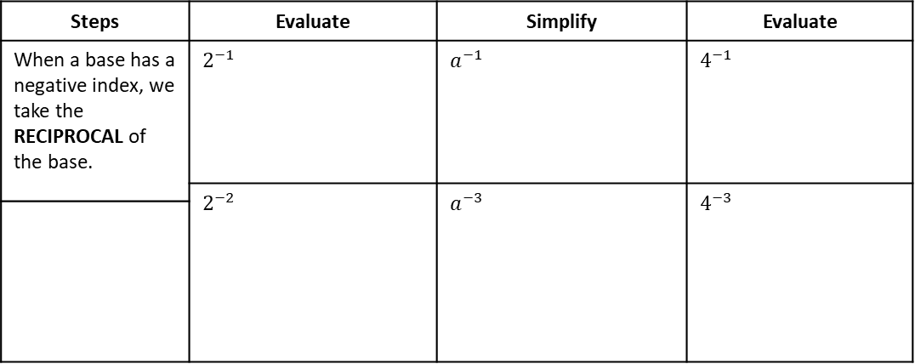
Example 7 - I do…
Example 8– We do…
Example 9 – You do…
Steps | Evaluate | Simplify | Evaluate
When a base has a negative index, we take the RECIPROCAL of the base. | $$2^{−1}$$ | $$a^{−1}$$ | $$4^{−1}$$
 | $$2^{−2}$$ | $$a^{−3}$$ | $$4^{−3}$$
INDEPENDENT PRACTICE
4. Simplify.
a) | b) | c) | d)
e) | f) | g) | h)
$x^{−2}$
$x^{−3}$
$x^{−4}$
$x^{−5}$
${(ab)}^{−2}$
${ab}^{−2}$
$a^{−2}$ $b^{−2}$
$$a^{2}b^{−2}$$
5. Evaluate.
a) | b) | c) | d)
e) | f) | g) | h)
i) | j) | k) | l)
m) | n) | o) | p)
2⁻²
3⁻²
10⁻²
4⁻²
9⁻²
8⁻²
7⁻²
6⁻²
$3^{−3}$
$4^{−3}$
$5^{−3}$
${10}^{−3}$
$$2^{−2}+2^{−3}$$
$$2^{−2}+3^{−2}$$
$$2^{−3}+3^{−2}$$
$$2^{−3}×3^{−2}$$

Slide 24
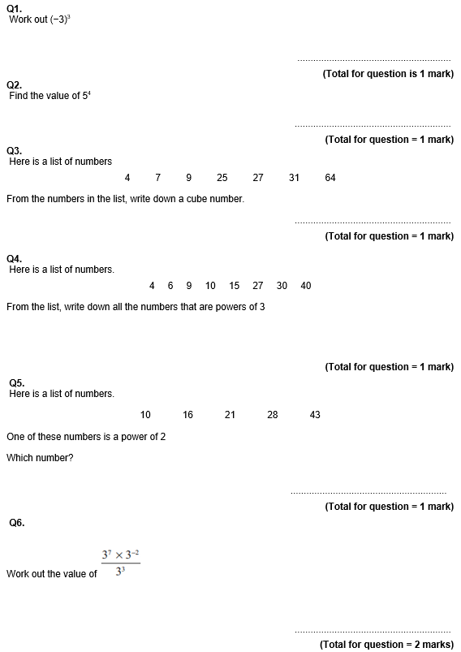
GCSE Past Paper Questions

Slide 25
